Slide 1


Integrating Parsons Puzzle with MyUni
Project ID 27
Jialun Han
Neha Wali
Peiting Sun
Supervised by Dr. Cheryl Pope

Slide 2
Structure of Demo
Project goal
Software Architecture
H5P structure
Limitation of access to MyUni
Integration with Drupal
Demo
Universal design
Future Extension

Slide 3
Project Goals
Gather information, research and design a universal parsons puzzle to implement it for the subjects where algorithmic thinking is required.
Development of environment settings: Integrating H5P into Drupal and MyUni(canvas interface).
Implementation of two types of parsons puzzle: Drag and Drop, and Fill in the blanks as customised H5P function.
Integrate customised H5P content type - Parsons Puzzle into MyUni.

Slide 4
Universal Design Implemented
It’s designed to support learning of syntax and logic by teaching problem solving through algorithmic thinking and visualization. Although designed for programming, it could be used for other procedural problems (mathematical proofs, experimental design, essay structure).
Predefined syntax rule
Hints and Support
Expected Actions
Tag: difficulty level
Grades
Attempt History
Progress
Student interface components
Instructor interface components for creating a problem
Flow control: Parsons Puzzle implementation

Slide 5

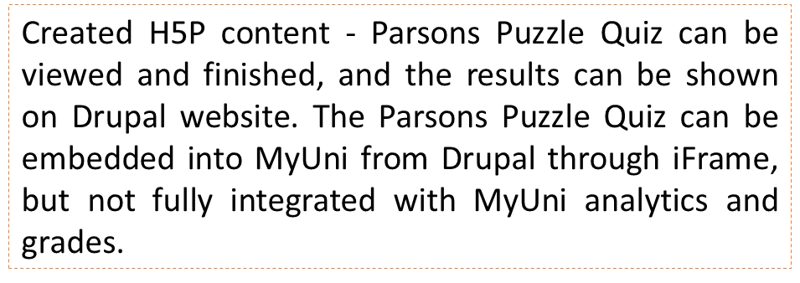



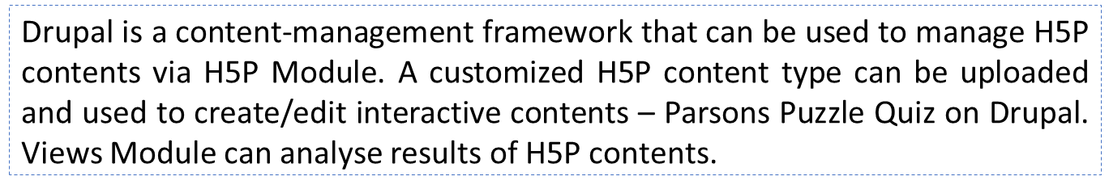





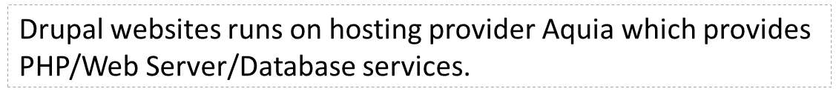

Software Architecture
User Interface
Drupal Site
MyUni - Canvas
Embedding
Parsons Puzzle Quiz – H5P
Parsons Puzzle Quiz
Feedback
Views Module
H5P Module
Content-Manage Framework
PHP
Web Server
Database
– Hosting Provider

Slide 6
H5P structure
We have used H5P because of its framework and that it can integrate with canvas interface(for MyUni). Front end support.
Interactive framework that helps to provide template for quiz creation for instructors which can be customised by instructors according to their requirement.

Slide 7

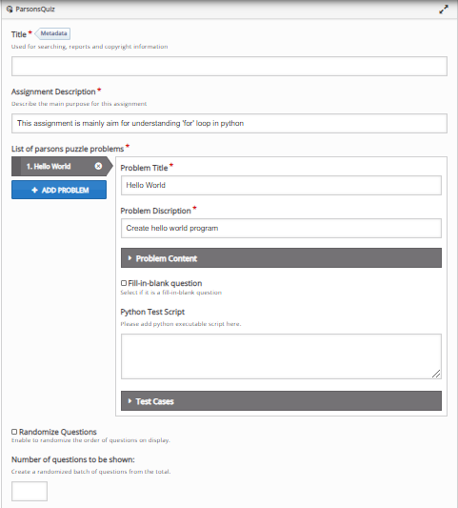


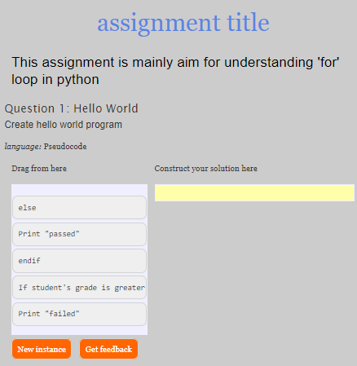
H5P structure
Metadata (library title , library description)
JS Libraries are used in parsons.js
lib
Parse instructor input
Initialize input value
h5peditor
CSS Libraries are used in parsons.js
semantics.json
library.json
style
H5p.js
(from Drupal h5p module)
Build parsons quiz h5p constructor and attach DOM to h5p container
Bring h5p container shown in page
H5P.ParsonsJS
H5P.jQuery
index.js
parsons.js
(GitHub open source code )
Contain the constructor of H5P library
Parsons quiz web page

Slide 8
Limitation of access to MyUni
Due to pandemic, we were unable to get access to integrate H5P into MyUni.
We tried downloading canvas interface but due to dependencies of libraries we were unable to do so.

Slide 9
Integration with Drupal
We used Drupal because it has less security problems.
It runs on Acquia which provides full back-end support.

Slide 10
Future Extension
Data Collection and Analysis
Models can be built to analyse the data and generate data of topics which are hard to comprehend for students by taking into account their attempt time, number of attempts, actions an grades. Instructor can use this data to give extra support on the hard topics.
Data can be used to monitor student’s progression, to keep a check on their performance and to analyse how the parsons puzzle is helping the students to understand the complex topics better.
Models can be built to analyse the learning pattern of each student. Instructors can divide the students into different groups based on their different cognitive processing strategies, regulation strategies and learning motivations.

